Slide 1

Stage 3 Photocator Team Members: Don McEachern, Ryan Liew, Sarina Zohdi, Bryan Hyunh, Sajid Choudhry Ta: Hessam Djavaherpour Team F

Slide 2
Project Idea
PhotoCator website
Connect with friends using social media linkage
Finding new photos using filtering and navigation
Uploading pictures using multipage design
Notes:
Talk about what our project does in more detail

Slide 3
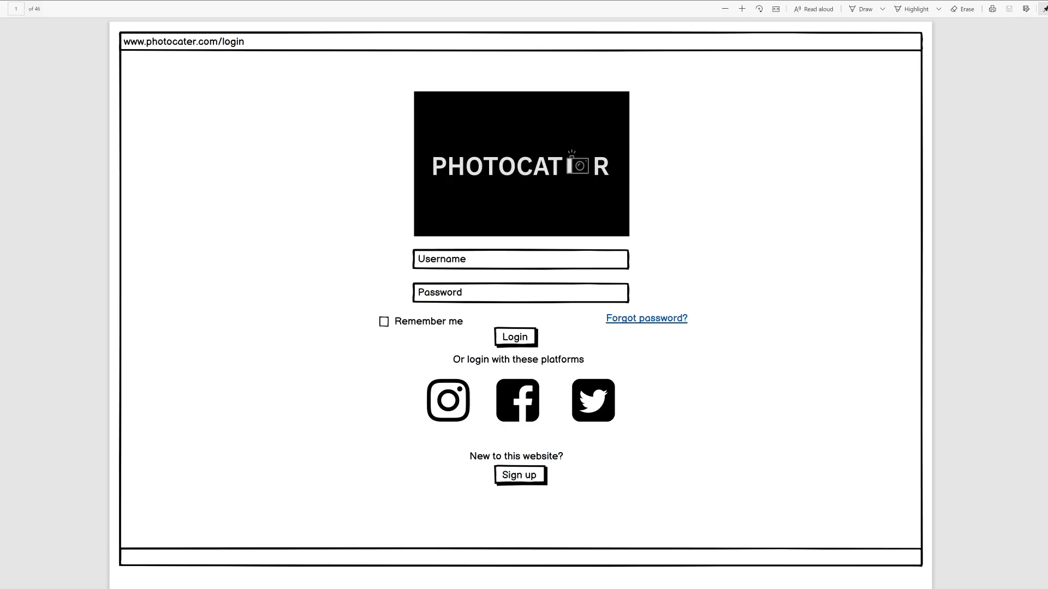
PROTOTYPE
DEMO
This is the demo for our website
Place your screenshot here
Notes:
Bryans

Slide 4
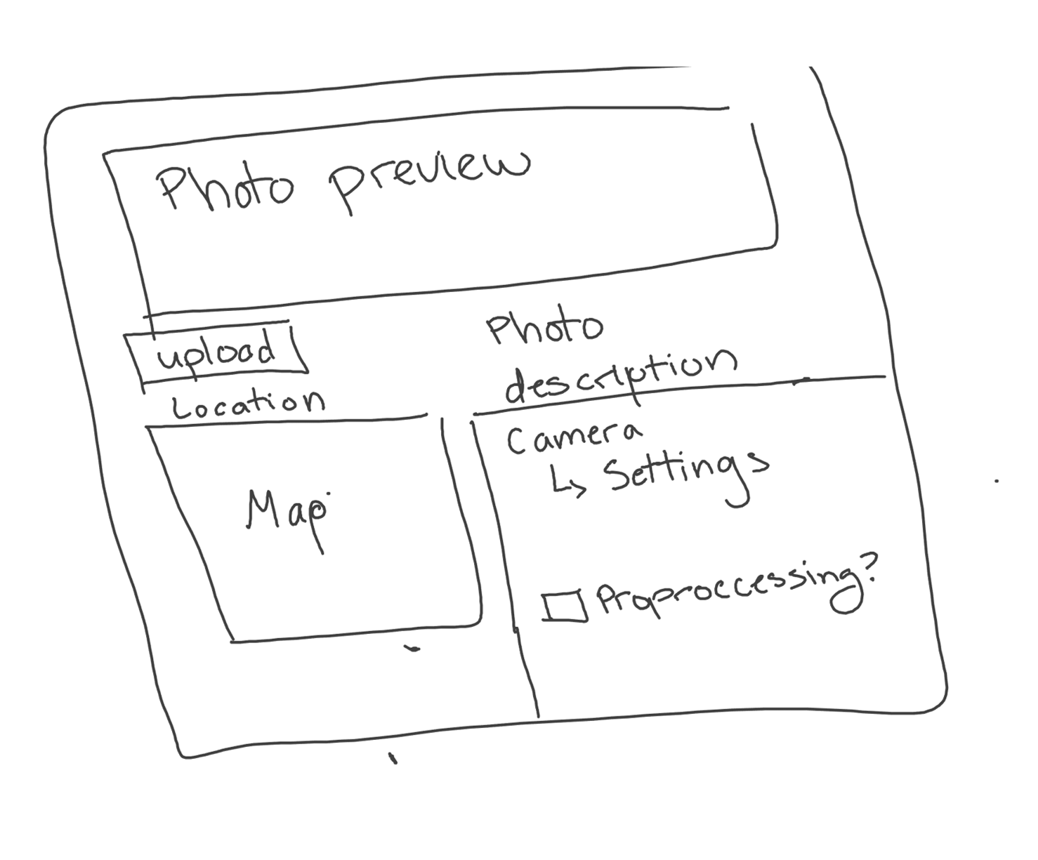
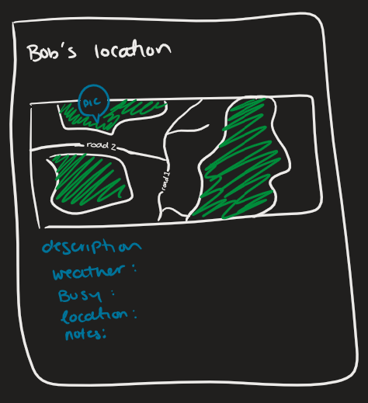
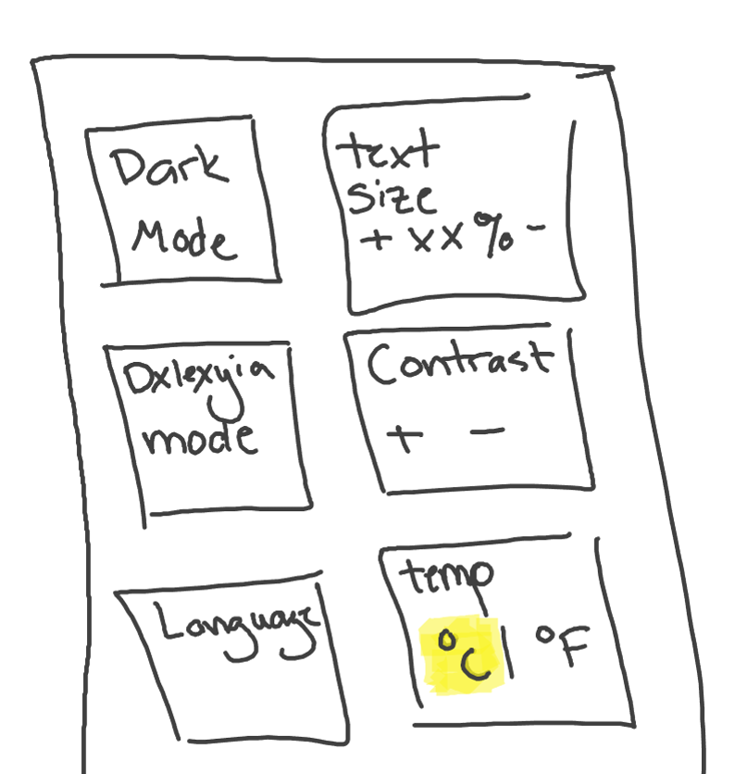
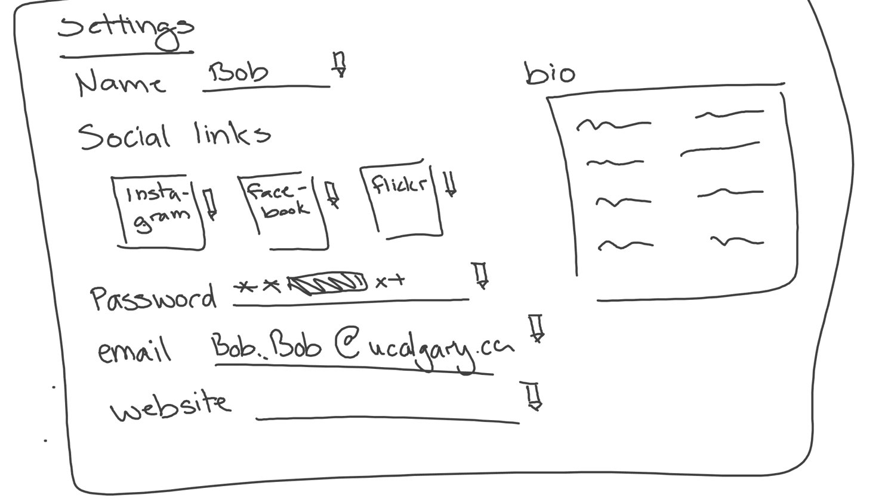
AFFINITY DIAGRAM
Quality Of Life/Usability
accessibility choice
Changing temperature format
FINDING LANDMARKS
Scrollable Map area
SHARING PICTURES
Saving Favorites
Increasing site text size
Customizable profiles
Credential based log in using various platforms (ex. Twitter, Facebook)
Changing your user profile
Add Notifications to the user
Toggling for comic sans
Changing language
Having dark mode
Menu visibility toggling
Changing user profile
Exploring popular images of a Landmark
Filtering
All pins appear in photo feed
A preview image with description when you click on an image
Search bar for finding pictures
Providing date and weather data for pictures
Busy alert for covid-19 reasons
Slider picture menu
A preview image with description when you click on an image
For finding area, using pin and radar
Manual location entry
Comments and reviews
Messaging client
Reviewing and commenting photos
Messaging people
Profile page
Viewing Contact list
Choosing a pin or radar to display location of the picture
Social Media linkage
Being able to click on the map when you upload an image
Reviewing pictures, and adding the location with pins and radars
Having in site friends and social media
Uploading a picture

Slide 5
OUR JOURNEY TO FINALIZING OUR STAGE 3
Brainstorming and Affinity diagrams
Story-board
Low-fidelity prototype
Cognitive Walktthro-ugh

Slide 6
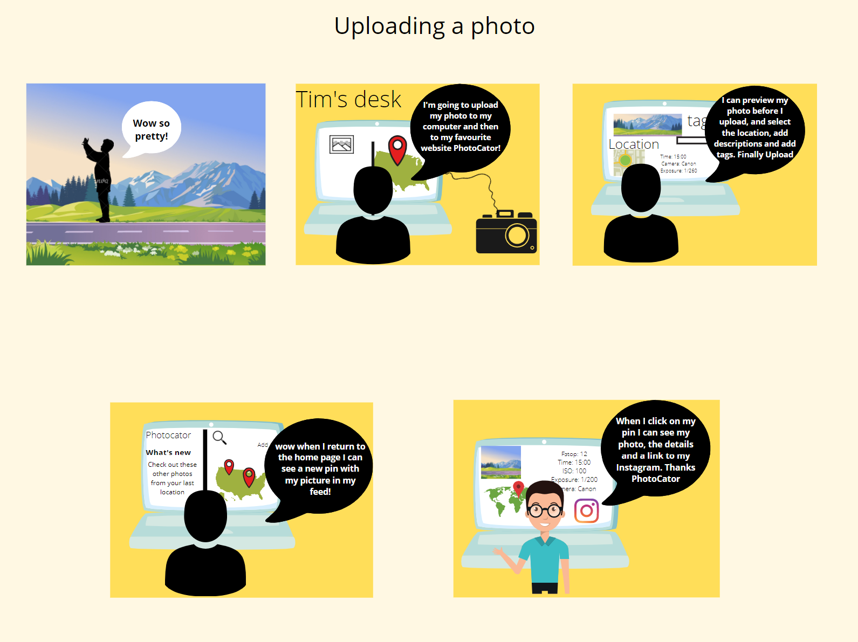
Storyboard

Slide 7
LOW-FIDELITY PROTOTYPE
What did we learn
Organized information
Making user workflow enjoyable
Fully functional prototypes without it being confusing for the reader

Slide 8
Cognitive walkthrough
What we learnt
What did we change

Slide 9
Thank you for watching!

